Slide 1
Web Technologies & Programming
Introduction to the Course

Slide 2
Road Map
Introduction
Why This Course
Market Value
Syllabus
Description
Books
CLOs
Lecture Plan
Mapping

Slide 3
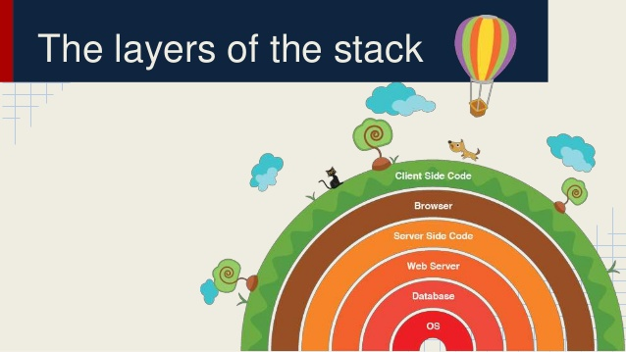
Why This Course
Full Stack Developer
LAMP/XAMP/WAMP
MEAN Stack
MERN Stack

Slide 4
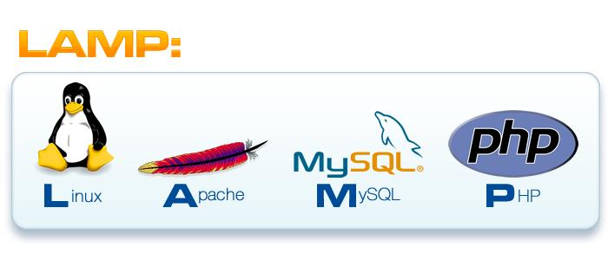
Why This Course
Full Stack Developer
LAMP/XAMP/WAMP
MEAN Stack
MERN Stack

Slide 5
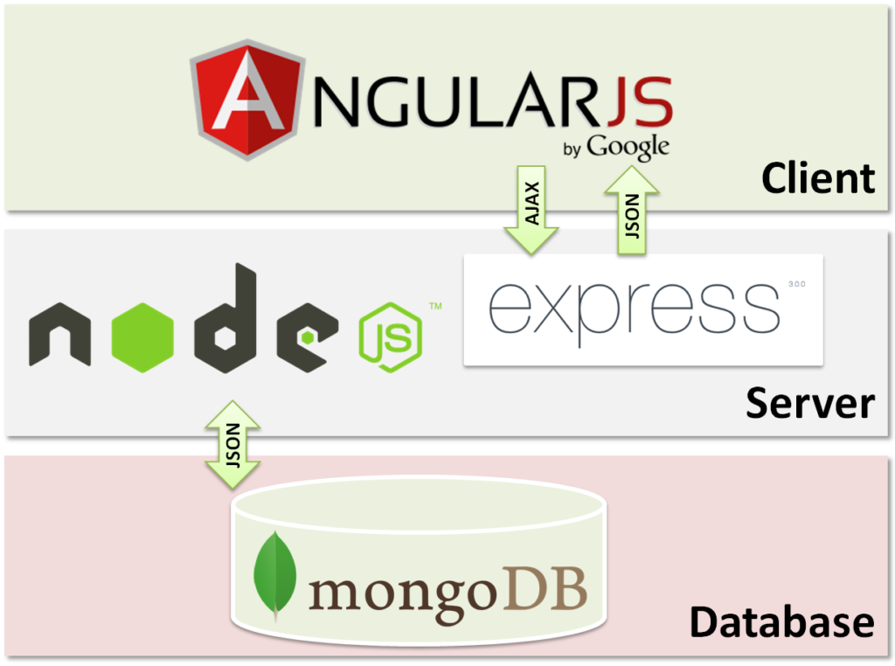
Why This Course
Full Stack Developer
LAMP/XAMP/WAMP
MEAN Stack
MERN Stack

Slide 6
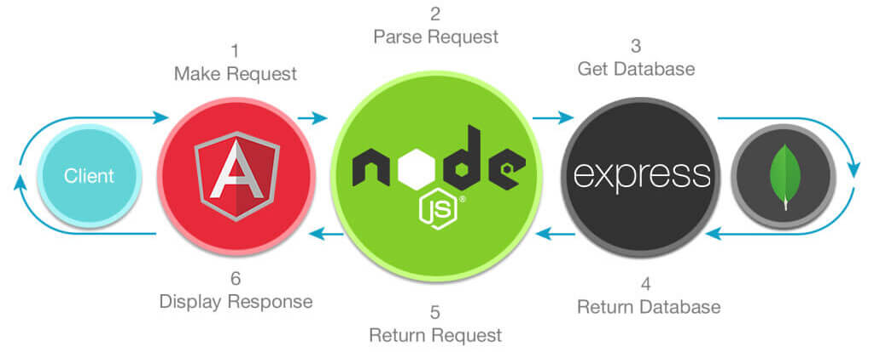
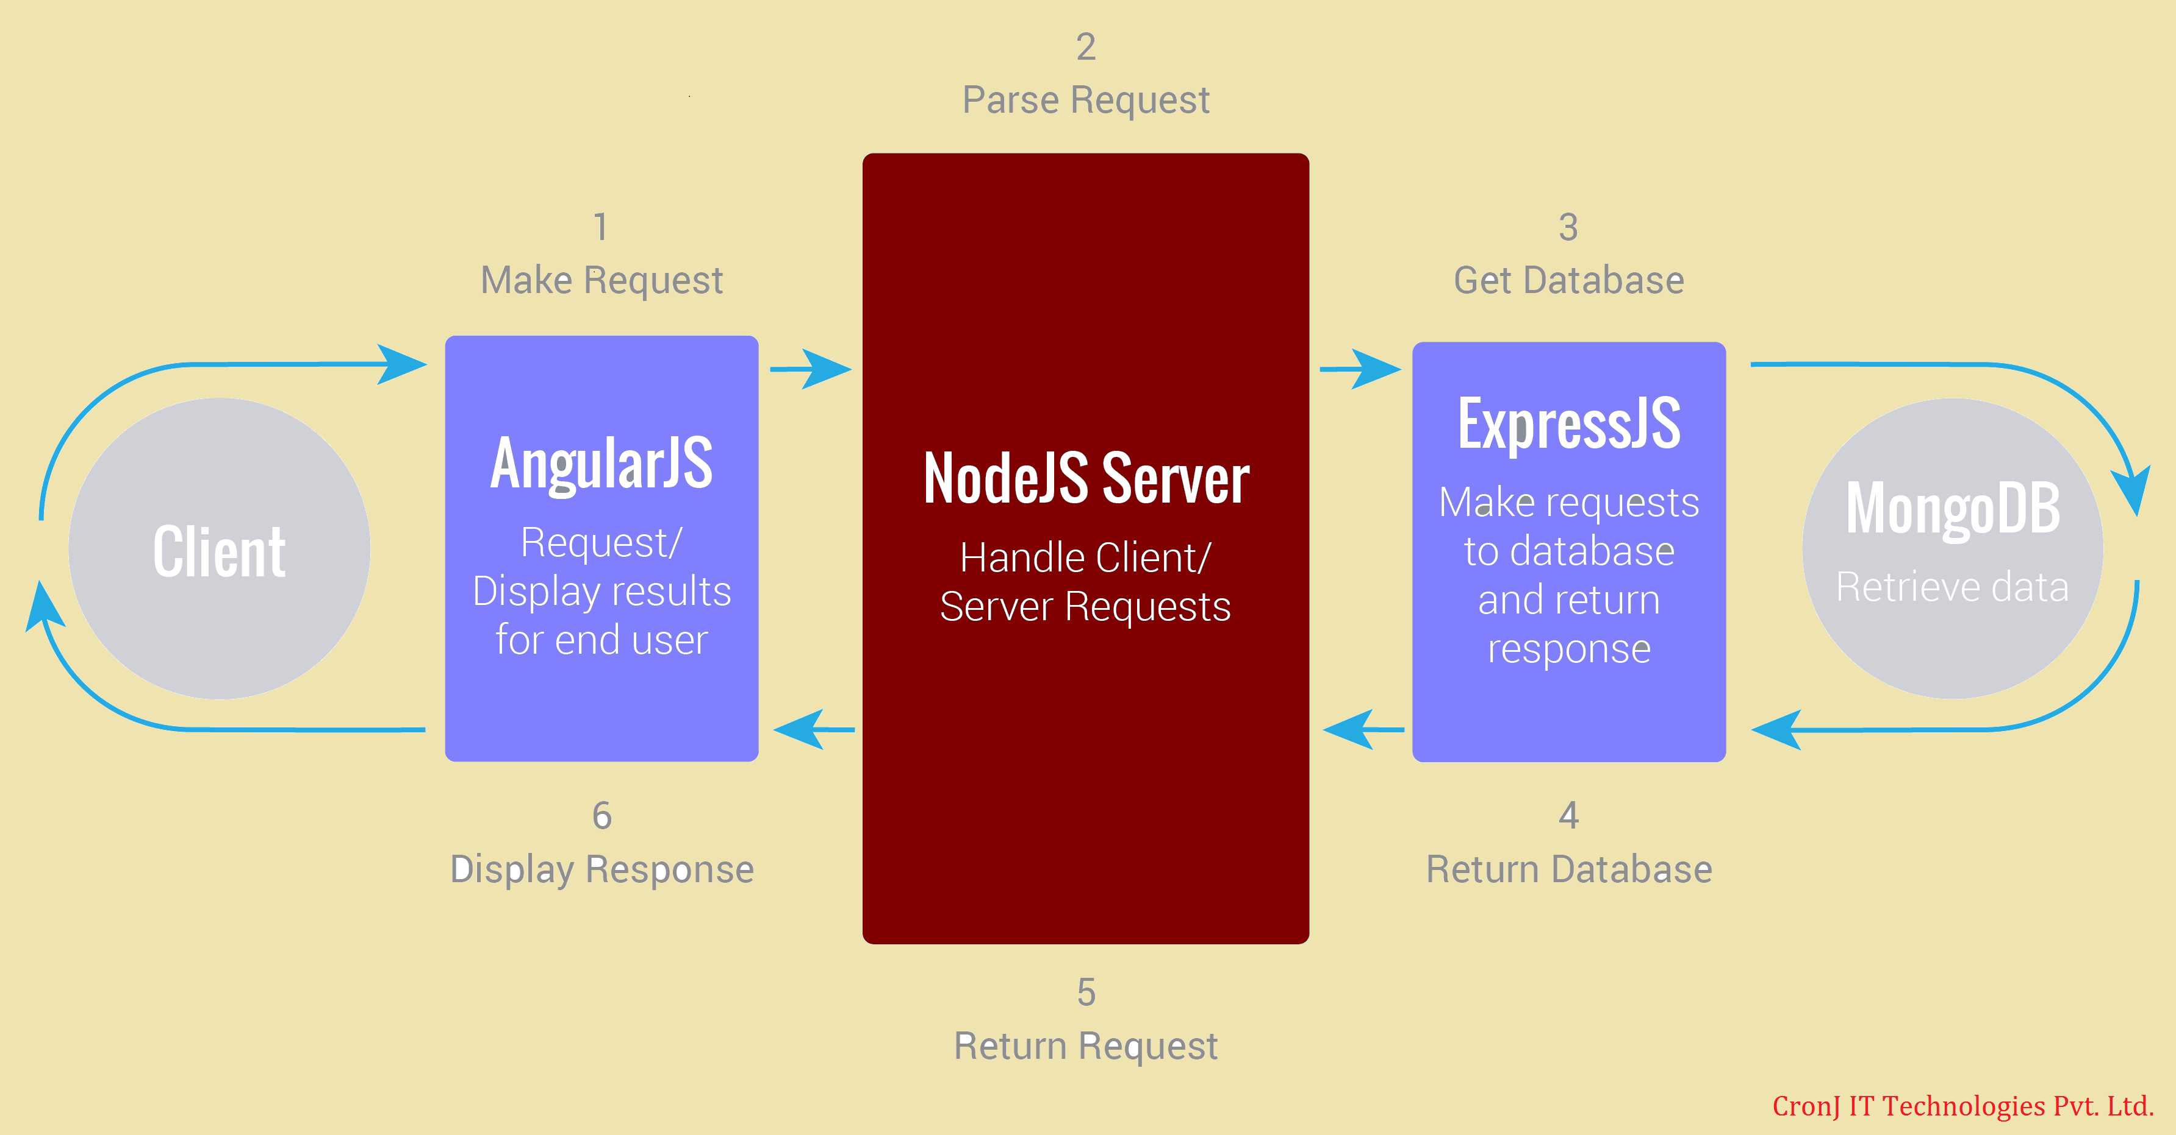
Why This Course
Full Stack Developer
LAMP/XAMP/WAMP
MEAN Stack
MERN Stack

Slide 7

Why This Course
Full Stack Developer
LAMP/XAMP/WAMP
MEAN Stack
MERN Stack

Slide 8
Why these stacks
1. Page Speed and server response
2. Overall Application Security

Slide 9
MongoDB
MongoDB - is a cross-platform and open-source document-oriented database, a kind of NoSQL database.
MongoDB is built for scalability, high availability and performance from a single server deployment to large and complex multi-site infrastructures.

Slide 10
Node.JS
Node.JS - Node.JS is a platform that is built on Chrome's JavaScript runtime for easily building fast and scalable network applications.
Node.js uses an event-driven, non-blocking I/O model that makes it lightweight and efficient, perfect for data-intensive real-time applications that run across distributed devices.

Slide 11
Express.JS
Express.JS - Express is a popular web framework, written in JavaScript and hosted within the node.js runtime environment.
It facilitates the Node Web Server in Response generation.

Slide 12
Angular
Angular - Angular is a structural framework for dynamic web apps. It lets you use HTML as your template language and lets you extend HTML's syntax to express your application's components clearly.

Slide 13
React.JS
React is a declarative, efficient, and flexible JavaScript library for building user interfaces.
It lets you compose complex UIs from small and isolated pieces of code called “components”.

Slide 14
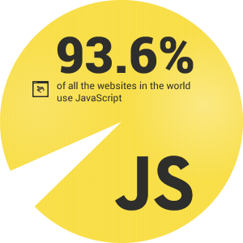
Market Value
70% hiring is of web development teams in local market
Meanstack Developer
React.JS Developer
Full Stack Developer
Framework developer(Laravel etc)
15% android Development
15% Game and Desktop Industry

Slide 15

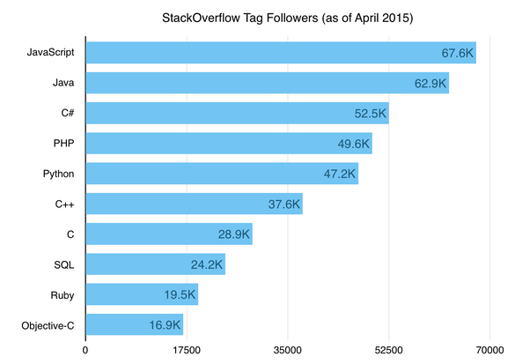




Slide 16
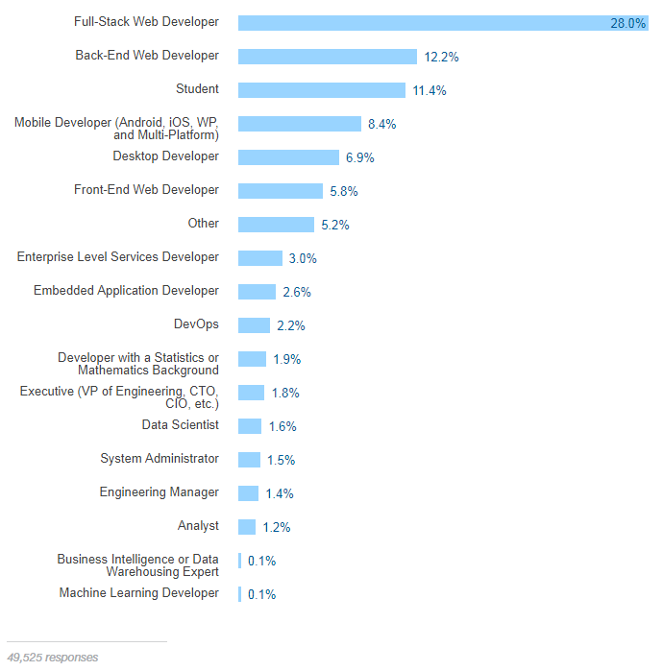

Slide 17
Syllabus
Description:
This course is aimed to give students the opportunity to heighten their abilities in Web Technologies & Programming. Students will learn to develop Web applications that use three-tier architecture, State of the art object-oriented techniques and advance database interactions. Advanced concepts such as NodeJS, Express.JS, MongoDB, Angular and React.JS will be explored.

Slide 18
Books
Web Development with Node and Express, Ethan Brown, (2014), O’Reilly Publishing
The Modern Web: Multi-Device Web Development with HTML5, CSS3, and JavaScript, Gasston, P., 1st Edition (2013). No Starch Press.
Building Modern Web Applications Using Angular, Shravan Kumar Kasagoni(2017), Packt Inc
Pro React, Cassio de Sousa Antonio(2015),APress Pub

Slide 19
Course Learning Outcomes
C1 | Describe advance concepts and technologies for developing web applications
C2 | Develop Web Server and REST API using modern technologies
C3 | Design web applications using object-oriented techniques
C4 | Develop dynamic clients using modern development technologies

Slide 20
Tentative Semester Schedule
Lecture | CDF Unit # | Topics Covered
1. | 1 | Introduction to the course, Roadmap, Full Stack Developing and importance of the course
2. | 1 | JSON, JSON Handling using PHP and JavaScript, AJAX using Jquery and XML handling in AJAX
3. | 1 | Introduction to MEANStack and Node.JS concepts and Modules
4. | 2 | NPM, Eventloop, Callback and Emitters
5. | 2 | HTTP Server,URL and Node-static
6 | 2 | File System(fs) in Node.JS
7 | 2 | Mongo DB
8 | 3 | MongoDB Client Connector
9 | 3 | Mongoose, Connecting MongoDB with Node.JS, CURD Operation
10 | 4 | Express Framework, Middleware, Routing and Routers
11. | 4 | Application architecture in Express.JS
12 |  | Sessional 1

Slide 21
Tentative Semester Schedule
Lecture | CDF Unit # | Topics Covered | Textbook Section
13 | 4 | Bootstrap and sample app in Express.JS | Ethan Ch 13
14 | 4 | Dynamic View Generating in Express.JS | Online Reference from JADE
15 | 4 | Session, Authentication and Local Storage Management in Express.JS, JWT | Ethan Ch 13
16 | 5 | REST Architecture principals | Ethan Ch 15
17 | 5 | RESTFUL Frameworks and API development | Ethan Ch 15
18 | 5 | Creating Complete REST API using Express.JS and REST Security | Ethan Ch 16-17
19 | 6 | TypeScript and Transpiling | Online Reference
20 | 6 | Introduction to Angular 9, Making Sample application with Angular Framework | Shravan Ch 1
21 | 6 | Decorators, Modules, Components and Data binding in Angular | Shravan Ch 2
22 | 6 | Templating, Directives, Pipes and Dependency Injections in Angular | Shravan Ch 3-4
23 | 6 | Services, Routing and Observable in Angular | Shravan Ch 5
24 |  | Sessional 2

Slide 22
Tentative Semester Schedule
Lecture | CDF Unit # | Topics Covered | Textbook Section
25 | 6 | Creating Complete MeanStack application with REST | Shravan Ch 6
26 | 7 | Introduction to React.JS, Props and states | Antonio Ch 1
27 | 7 | Routing, JSX and creating components in React.JS | Antonio Ch 2-3
28 | 7 | React Forms | Antonio Ch 4
29 | 7 | React Fetch and Axio | Antonio Ch 5
30 | 8 | Redux, Thunk and Unit Testing | Online Resource
 |  | Terminal Examination

Slide 23
Tentative Assessment Schedule
Artifact | Due Date | Unit | CLO
Quiz 1 | Week 2 | 1 | 1
Assignment 1 | Week 3 | 2 | 2
Sessional 1 |  |  | 1,2
Quiz 2 | Week 7 | 4 | 2
Assignment 2 | Week 7 | 5 | 2
Quiz 3 | Week 8 | 6 | 3
Assignment 3 | Week 9 | 6 | 3
Sessional 2 |  |  | 2,3
Assignment 4 | Week 12 | 7 | 4
Quiz 4 | Week 12 | 7 | 4

Slide 24
ANY THING ELSE?

